Slide 1
Presentation Raytracer
Group members:
Rutger van den Berg 4060156
Ymte Jan Broekhuizen 4246586
Qu Chen 1256025
Arend Jan de Graaff 4012534
Max Groeneboom 4169298
Rick van Hattem 1297295
Ewoud van der Heide 1534033
Leon Hoek 4021606
Vince Kasanpawiro 4028880

Slide 2
Competition Image
Our product
//

Slide 3
Work Distribution
Distribution by team member
Rutger: Debugging Linux, reflection, 3d models.
Ymte Jan: Octree, multithreading, RealTime RayTracing, shadows, motion, ground textures, Phong shaders.
Qu: Debugging Visual Studio, Ray-Intersection,
presentation.
Arend Jan: Windows operations, 3d models, presentation.
Max: Ray-Intersection, 3d models, shadows, FPS counter
Rick: Multithreading, 3d models, debugging McOS, hosted git, timer, rewriting, background raytracing, FPS counter, RealTime RayTracing
Ewoud: Colouring, 3d models, Debugging Linux
Leon: Octree, debugging Linux, 3d models
Vince: 3d models, presentation, debugging Visual Studio

Slide 4
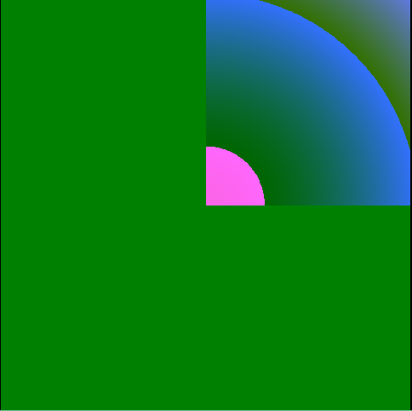
Psychedelic Art
Very first attempt

Slide 5
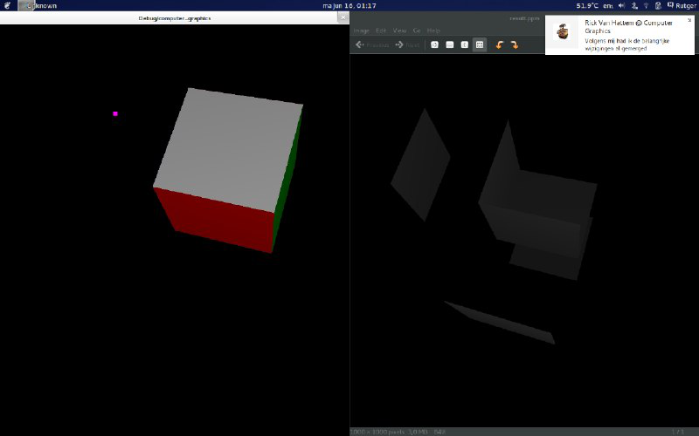
Cube Rendering
Start of project

Slide 6
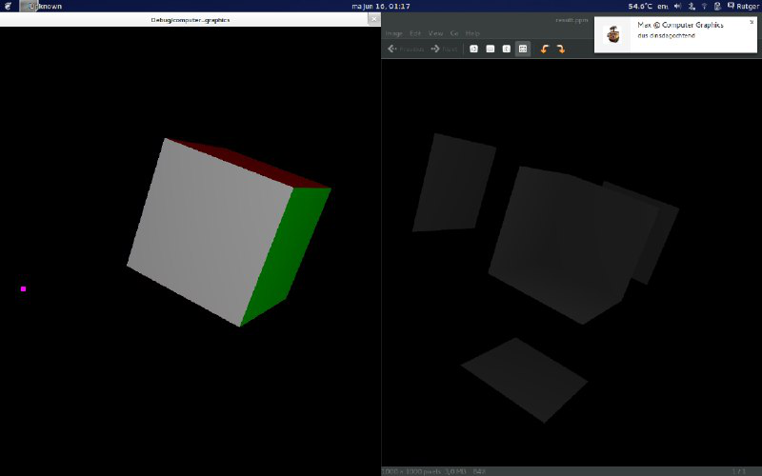
Cube Rendering
Start of project

Slide 7
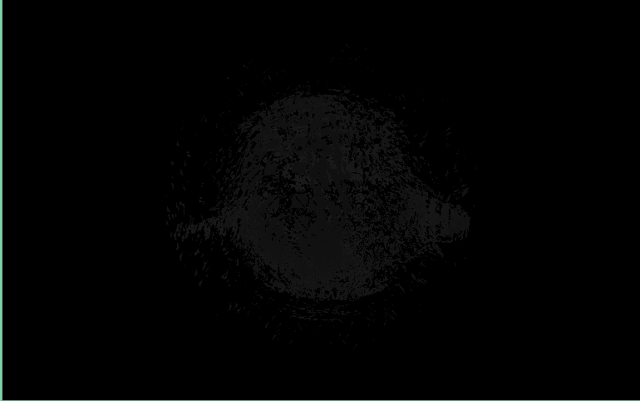
Monkey Rendering
Start of project

Slide 8
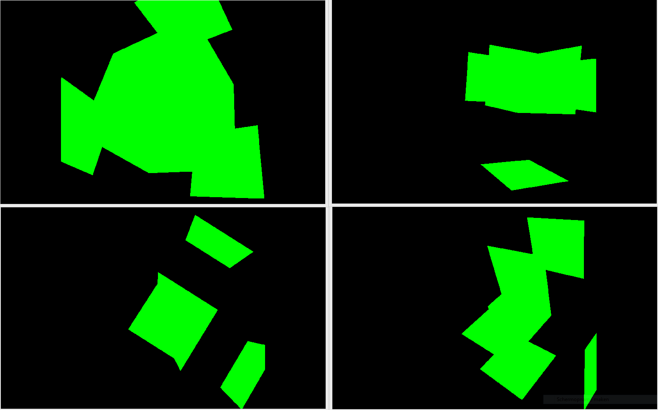
Geometric Ray Tracing
Raytracing

Slide 9
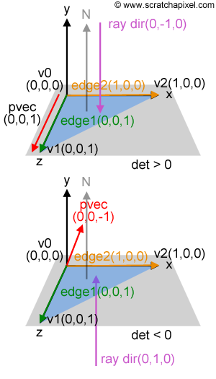
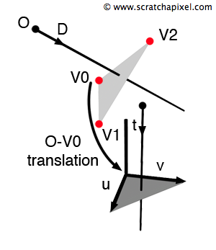
Solution
Raytracing - Möller Trumbore intersection method

Slide 10
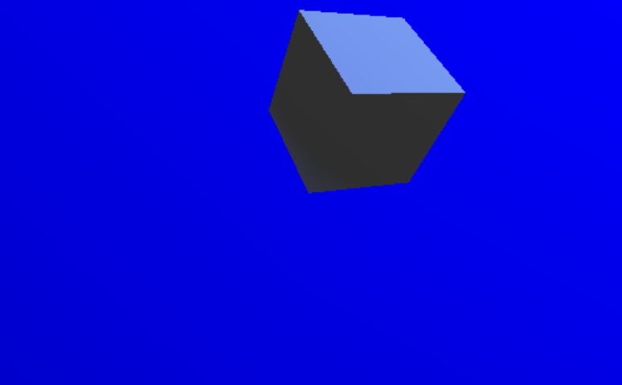
Result
Raytracing - intersection working

Slide 11
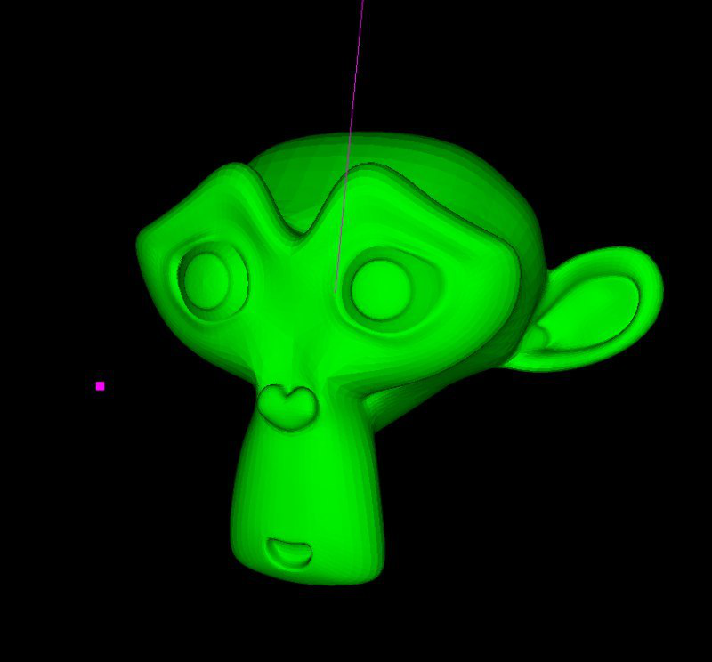
New Mesh
Normals - Blender’s monkey

Slide 12
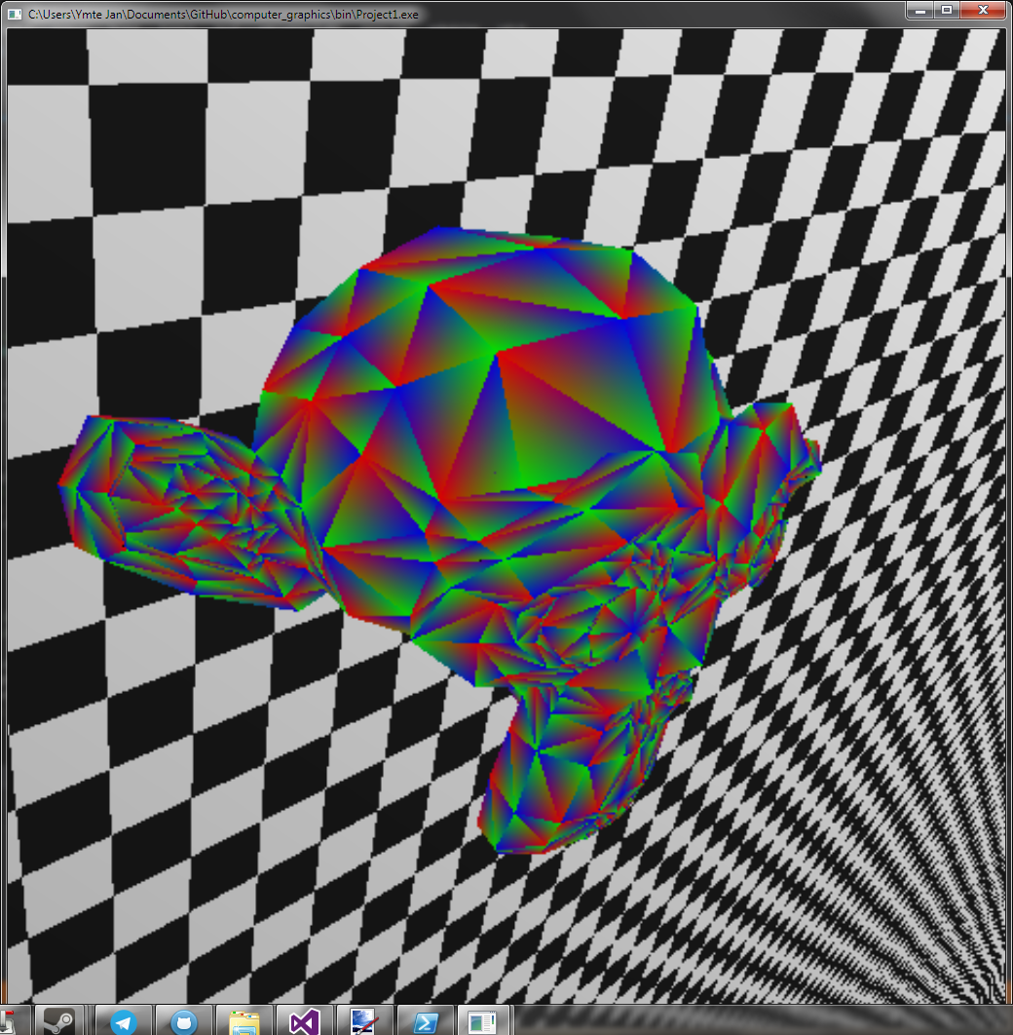
Blinn-Phong
Normals - used as colour

Slide 13
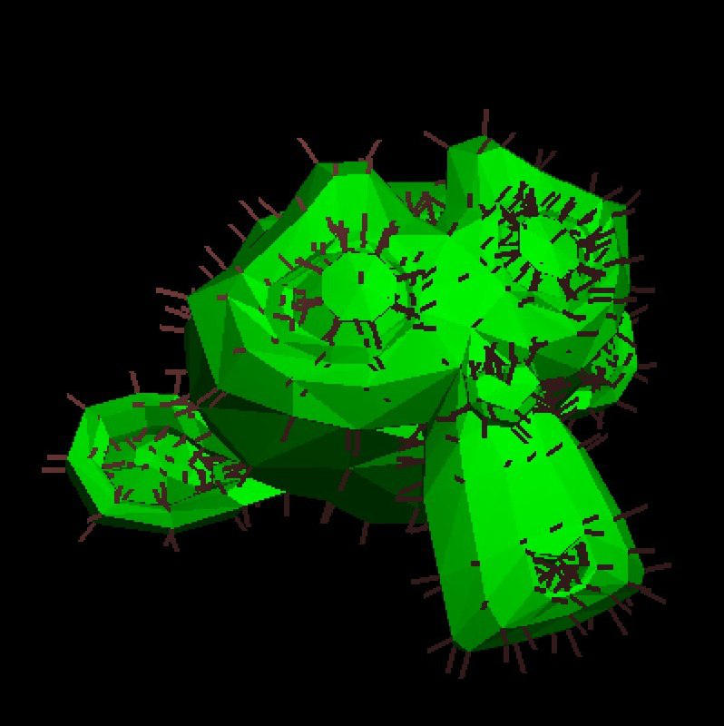
Actual normals
Normals – Using simpleMonkey

Slide 14
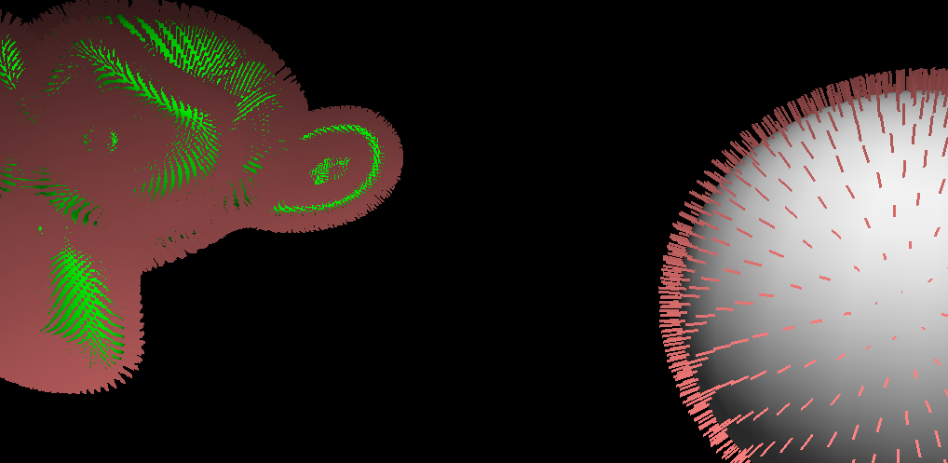
Actual normals
Normals – Applied to other models

Slide 15
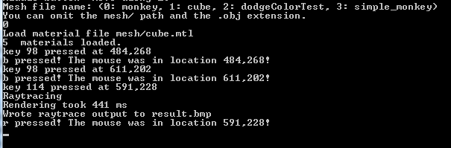
Challenges
Duration

Slide 16
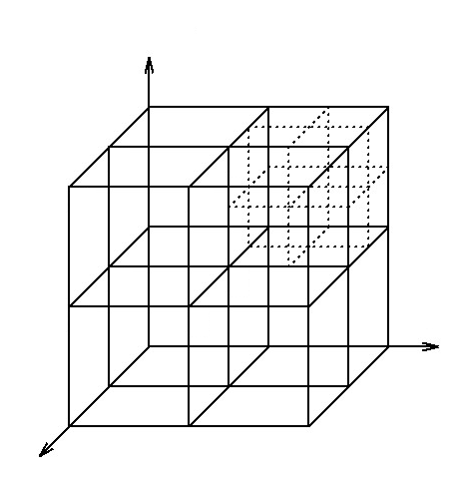
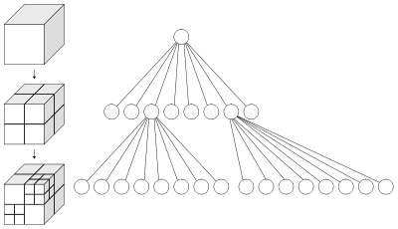
Octrees
Duration – possible solution

Slide 17
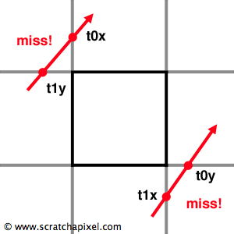
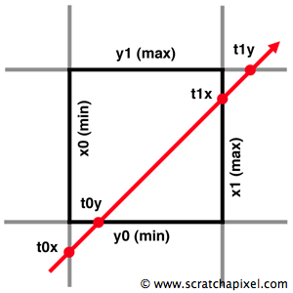
Octrees
Duration – possible solution

Slide 18
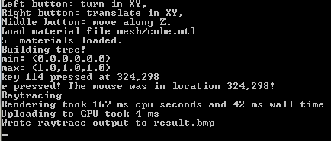
Octrees
Duration – result

Slide 19
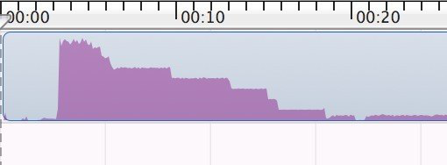
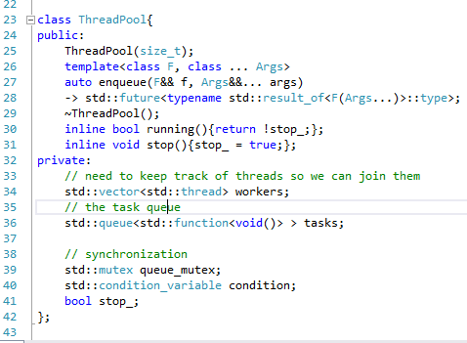
Multithreading
Duration – possible solution

Slide 20
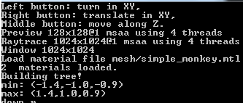
Multithreading
Duration – result

Slide 21
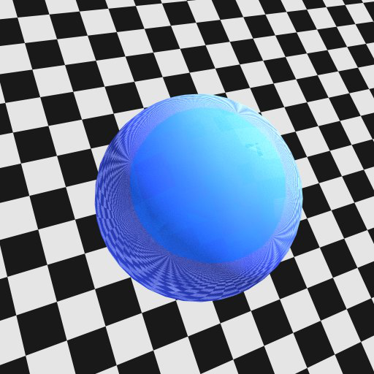
Reflection
Extras

Slide 22
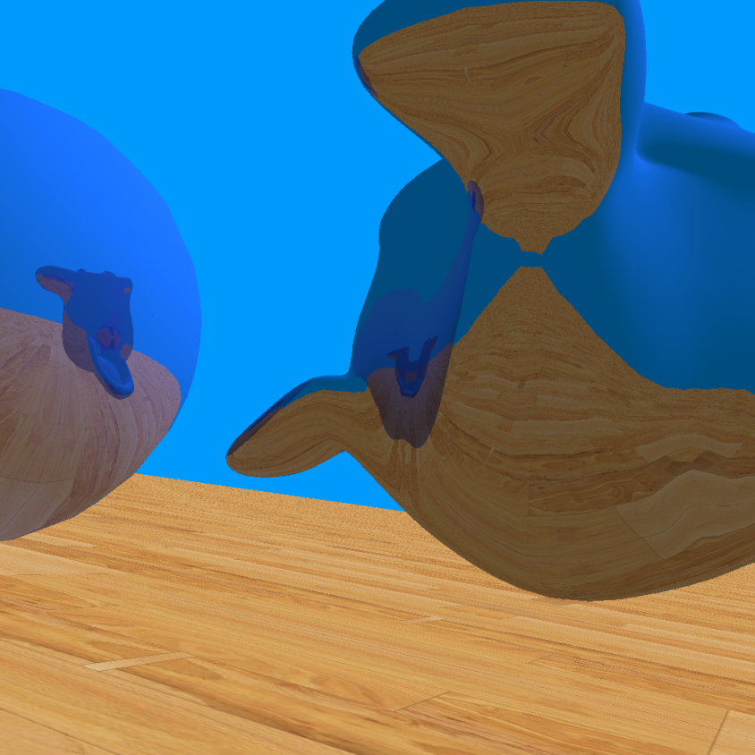
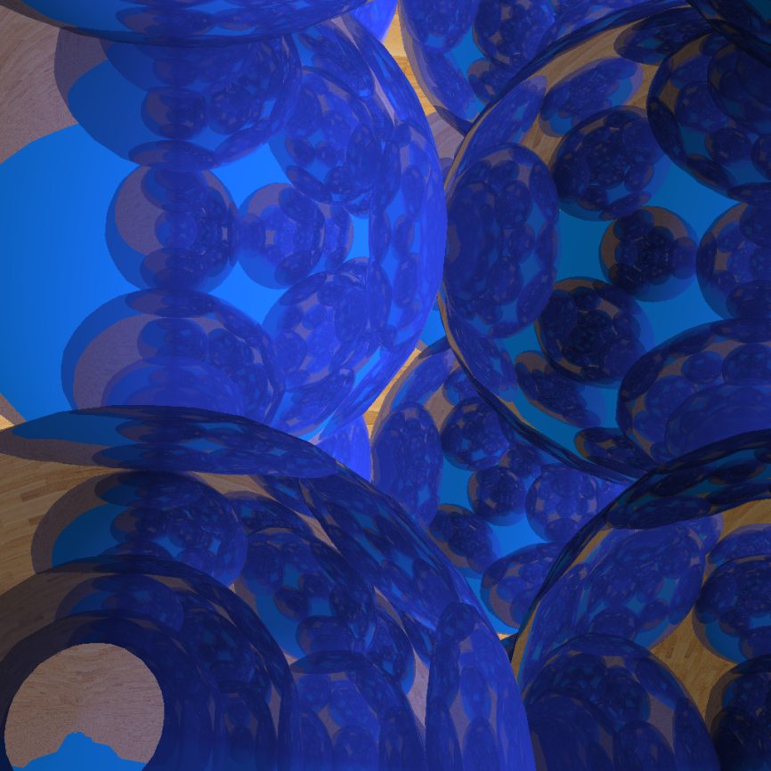
Reflection, onto other objects
Extras

Slide 23
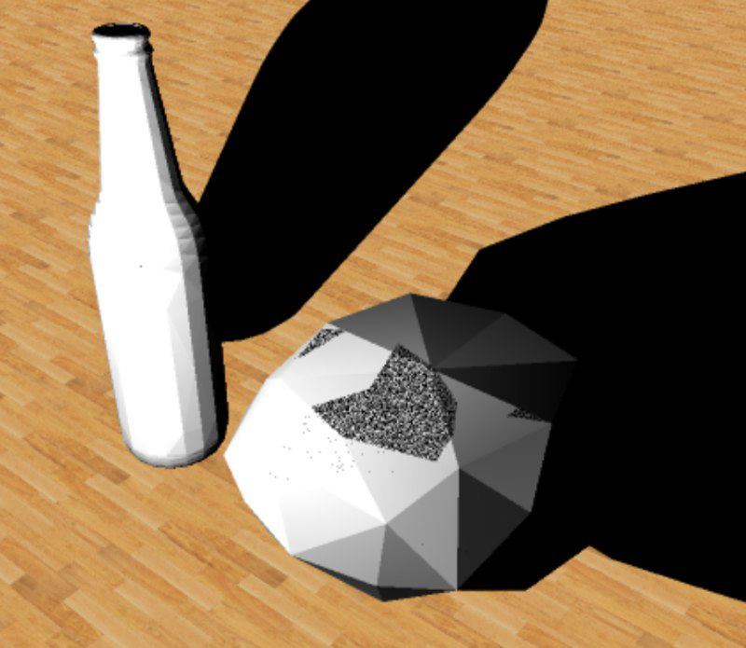
Schadows
Extras

Slide 24
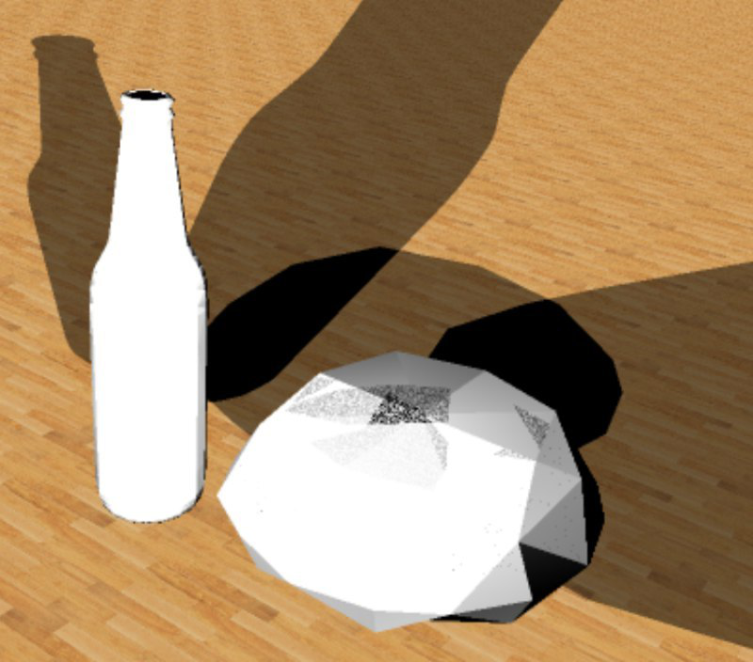
Schadows, multiple light sources
Extras

Slide 25
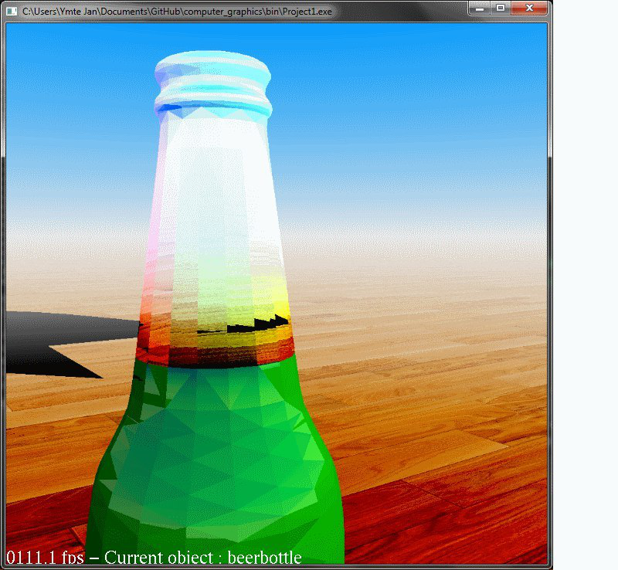
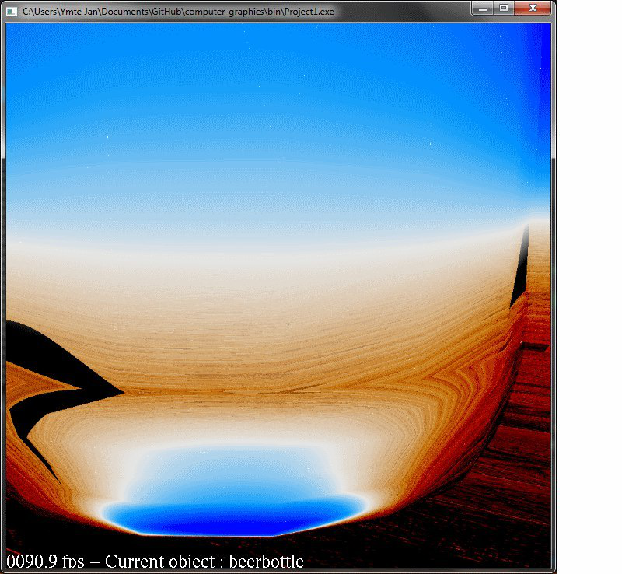
Refraction
Extras

Slide 26
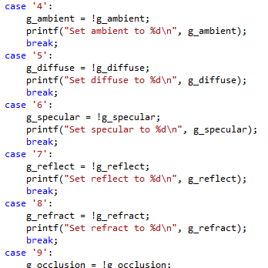
Toggle functions
Extras

Slide 27
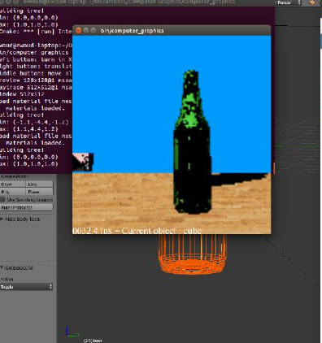
Live demo
Extras

